Slide 1



Capstone Project - III
Supervised ML -Classification Credit
Card Default Prediction
BY- ANMOL SACHDEVA

Slide 2
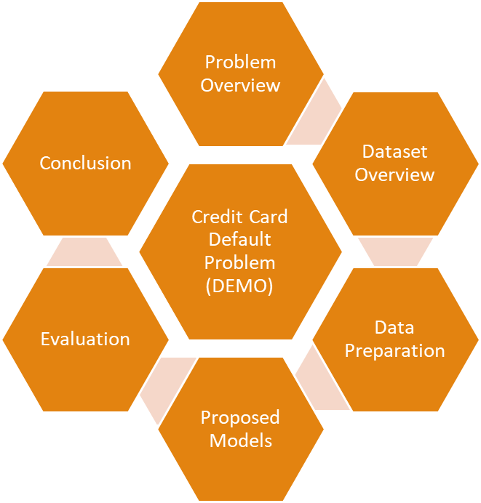
Agenda

Slide 3
Overview
Banking / Financial Institutes plays a significant role in providing financial service.
To maintain the integrity, bank/institute must be careful when investing in customers to avoid financial loss.
Before giving credit to borrowers, the bank must come to about the potential of customers.
The term credit scoring, determines the relation between defaulters and loan characteristics.

Slide 4
GOAL
The model we built here will use all possible factors to predict data on customers to find who are defaulters and non-defaulters next month.
The goal is to find the whether the clients are able to pay their next month credit amount.
Identify some potential customers for the bank who can settle their credit balance.
To determine if their customers could make the credit card payments on-time.
Default is the failure to pay interest or principal on a loan or credit card payment.

Slide 5
Process Design
The process is done by Supervised learning Algorithm.
The idea behind using this is we have a prior knowledge on our output values.
It acts as a guide to teach the algorithms what conclusion it should come up with.
Common algorithms in supervised learning includes logistic regression, Decision tree Classifier, Random Forest , support vector machines, Gradient boosting . xtreme Gradient Boosting

Slide 6
Approach Design
Analyse the Best model
Applying
models
Comparing the
applied models
Evaluation
Model
Preparation
of data

Slide 7
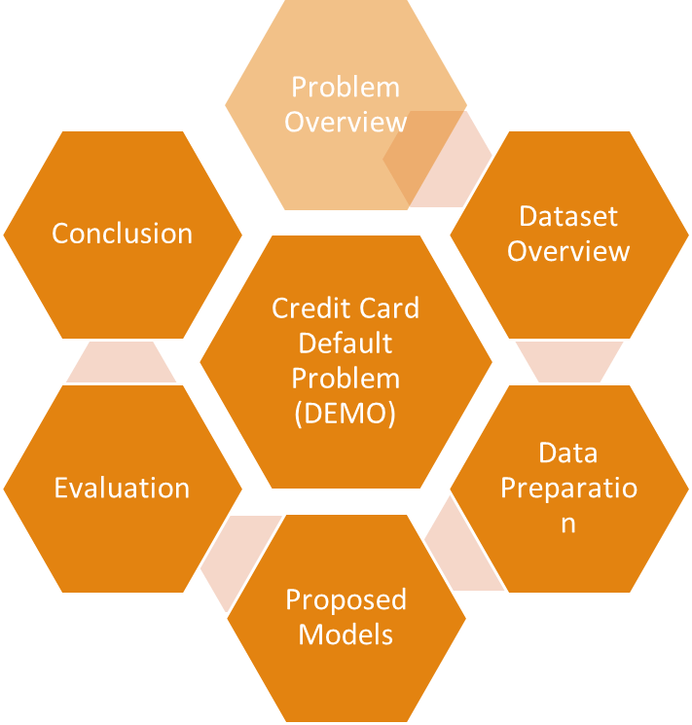

Slide 8
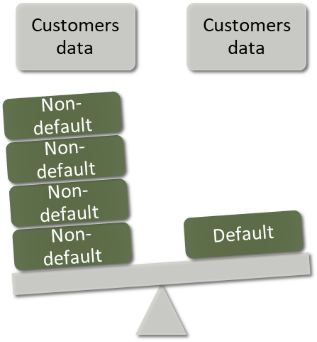
Dataset Overview
Oriented: UCI Machine Learning Repository.
Attributes: 24
Tuples: 30,000

Slide 9



Continue…
•
Customer ID
•
Credit limit
•
Gender
•
Age
•
Independent
variables:
Marital status
•
Level of education
•
History of their past payments made (April to September) (g1 to g6)
•
Amount of bill statement (h1 to h6)
•
Amount of previous payment (i1 to i6)
Dependent
variables:
default – A customer who will be default
next month payment (0: no, 1: yes)

Slide 10
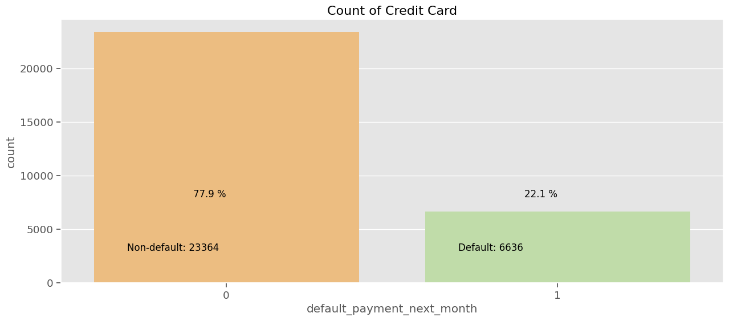
Dataset overview
Graph shows total number of records for defaulters and non-defaulters.
If they would do payment or not (yes=1 no=0) for next month
22.1% - default
77.9% - non-default
From the above data analysis we can say that
0 - Non Default
1 - Defaut
Defaulters are less than the Non Defaulters in the given dataset.
As we can see from above graph that both classes are not in proportion and we have imbalanced dataset. we need to do normalize the data

Slide 11
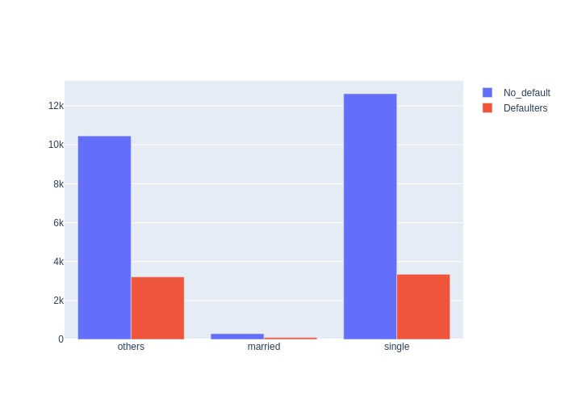
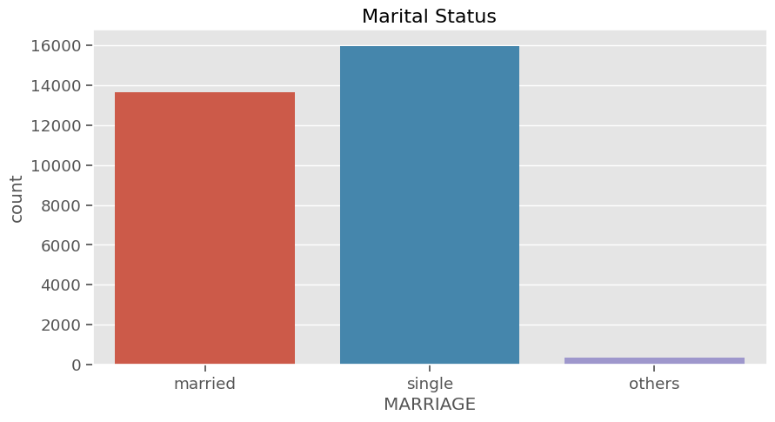
Continue…
It shows default count for ‘marriage’ attribute
0,3 - Others, 1 - Married, 2 - Single
Single - 15964
Married - 13659
Others - 377
WHat is the number of defaulters and non defaulters according to the marital status.
Defaulters
Single - 3341
Married - 3206
Others - 89
No_Default
Single - 15964
Married - 12623
Others - 288

Slide 12
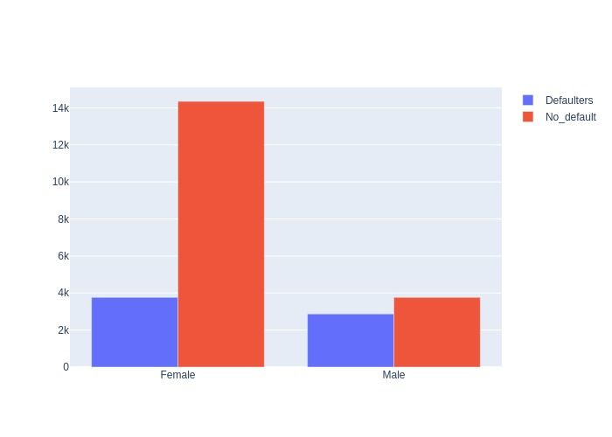
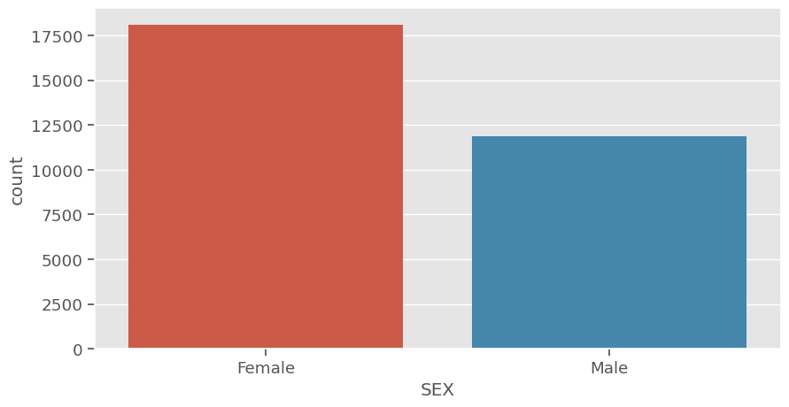
Continue…
It shows count for ‘sex’ attribute
1 - Male and 2 - Female
Male - 11888
Female - 18112
WHat is the number of defaulters and non defaulters according to the SEX.
Defaulters
Male - 2863
Female - 3773
No_Default
Male - 9015
Female - 14349

Slide 13
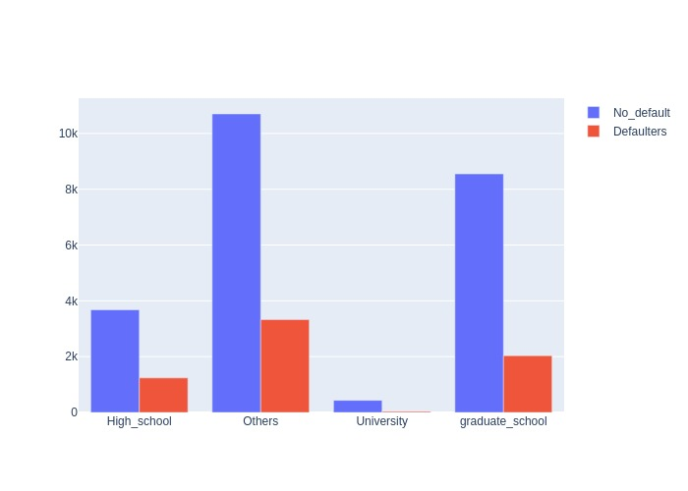
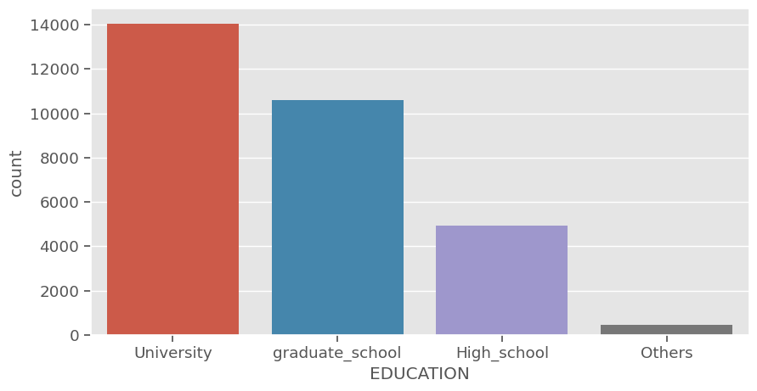
Continue…
It shows count for ‘Education’ attribute
1- graduate school,2 -university,3 -high school,4- others
University - 14030
graduate_school - 10585
High_school- 4917
Others- 468
WHat is the number of defaulters and non defaulters according to the education.
Defaulters
University - 3330
graduate_school - 2036
High_school- 1237
Others- 33
No_Default
University - 10700
graduate_school - 8549
High_school- 3680
Others- 435

Slide 14
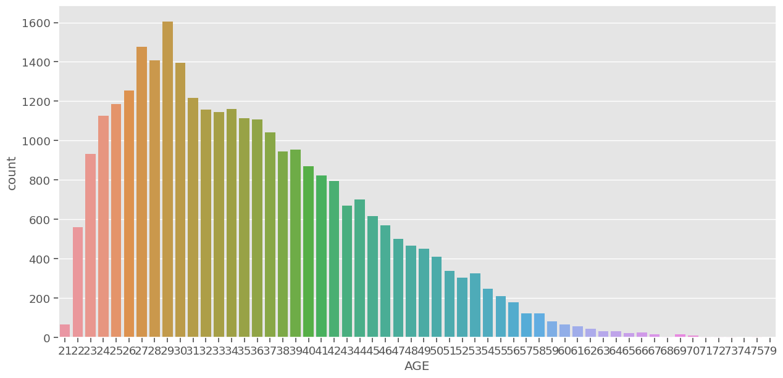
Continue…
We can see more number of credit cards holder age are between 26-30 years old.
From the above data analysis we can say that
*
Age above 60 years old rarely uses the credit card.

Slide 15
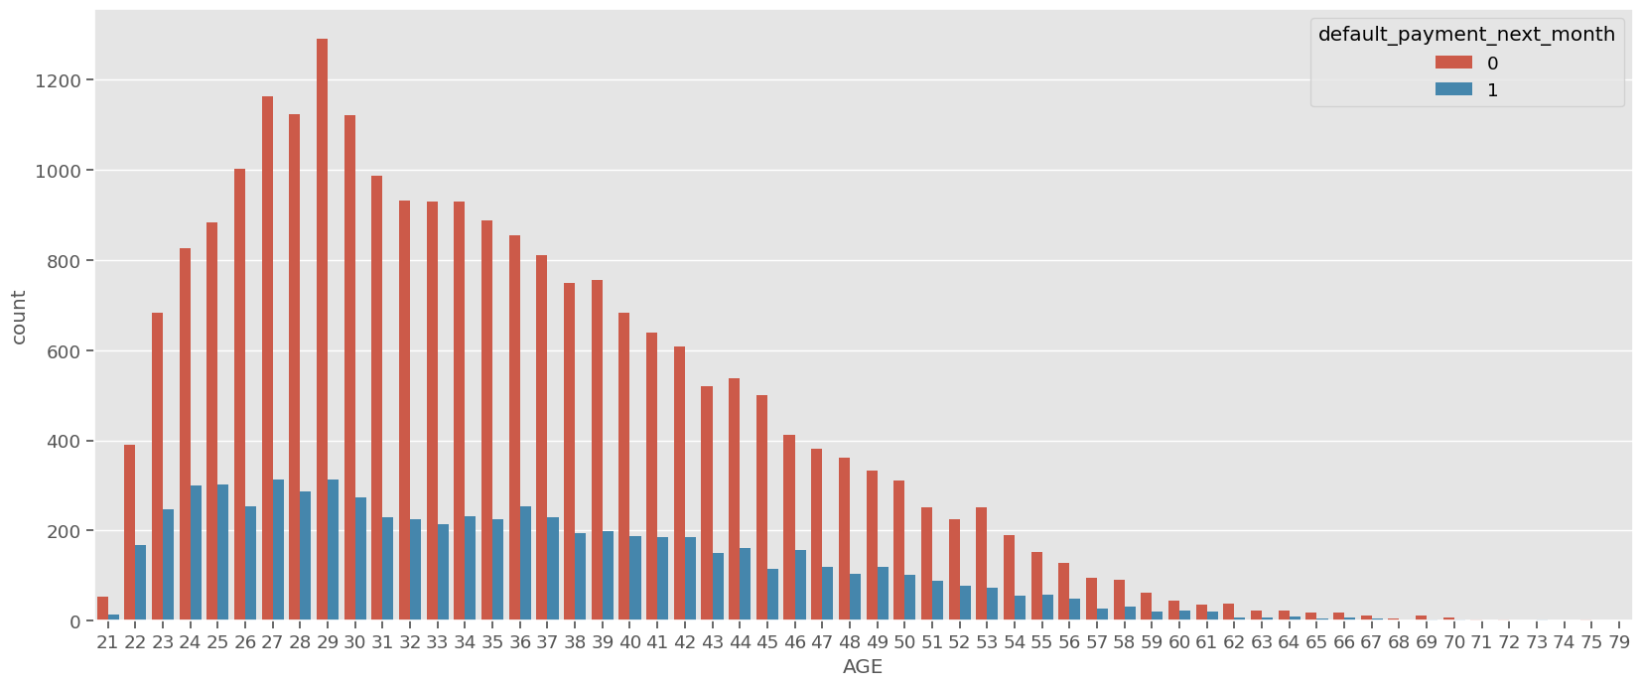
Continue…
What is the count of defaulters according to the age group.
So we have found our age group where maximum nuber of defaults have occured.
The age group 27 and 29 have showed maximum number of defaults which are 313

Slide 16
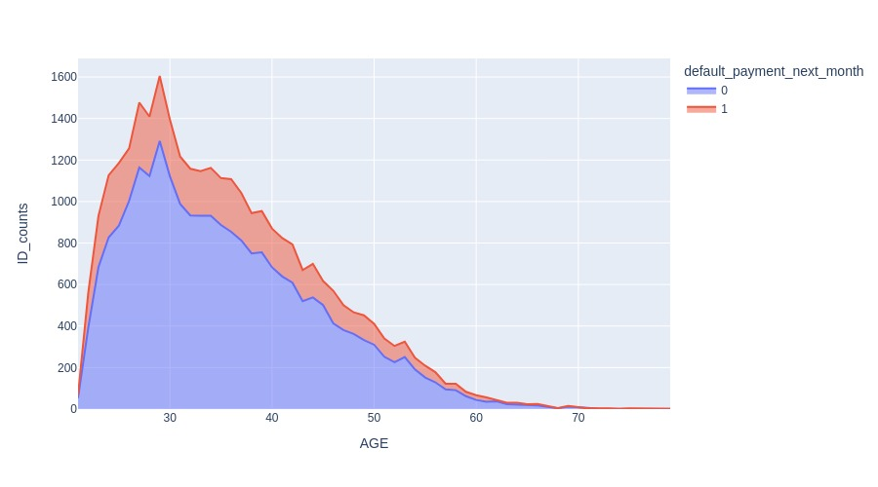
Continue…
THe Graph is showing the age group which have been involved in maximum nuber of defaults.
The age group of 27 and 29 is showing maximum number of defaults from all the defaults.
But the another fascinating information we can extract from here is, the age group with maximum nuber of non defaults also lies on 27 to 30

Slide 17
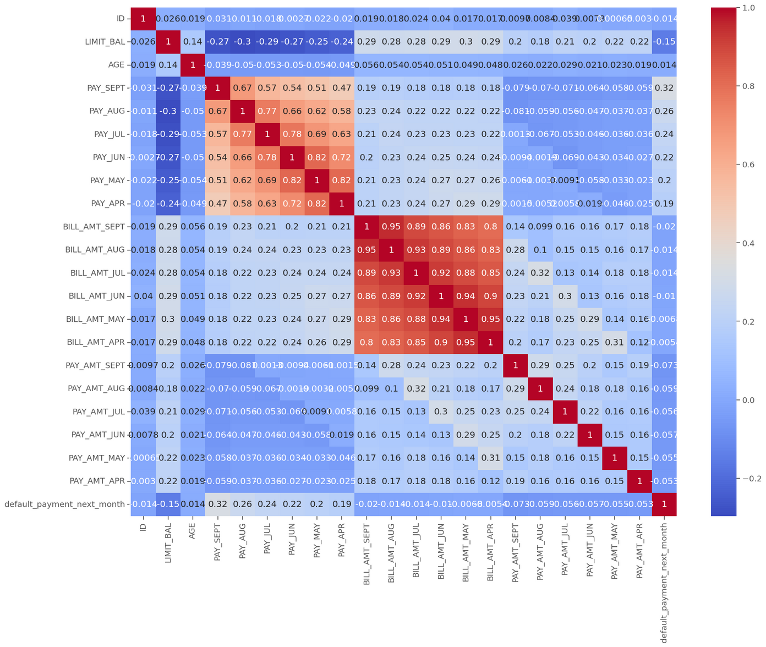
Checking of Correlation between variables

Slide 18
We check correletion betweeen variables using Correlation heatmap, it is graphical representation of correlation matrix representing correlation between different variables
ID is unimportant and it has no role in prediction so we will remove it.
It seems from the above graph is there are some negatively correlated feature like age but we cannot blindly remove this feature because it could be important feature for prediction.

Slide 19
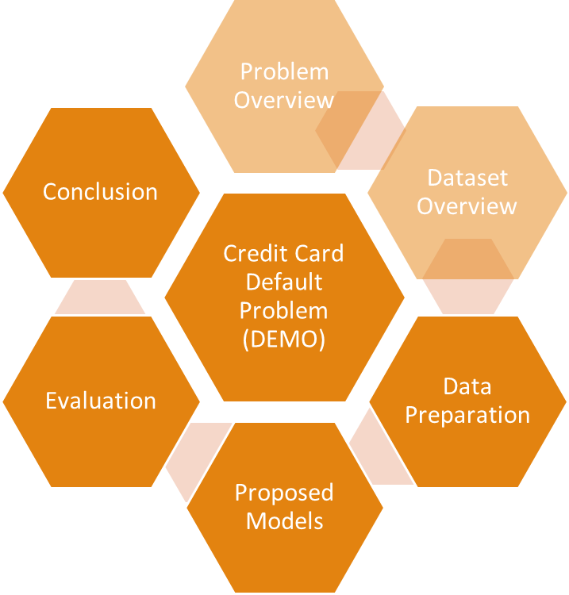

Slide 20
Data Preprocessing
Data set is divided in 80:20 ratio for train and test respectively.
ID column was dropped as its unnecessary for our modeling.
The attribute name ‘PAY_0’ was converted to ‘PAY_1’ for naming convenience.
Pay_0: No consumption of credit card=-2, Pay duly(paid on time)=-1, payment delay for one month=1, payment delay for two months=2, payment delay for nine months and above=9.
Marital Status 0 is converted to value 3 (Others).
No Null values in dataset.

Slide 21


Feature Engineering
Marital status Value
_ 0
Married 1
single 2
Others 3
Education Value
Graduate
University
High School
Others
1
Gender value
2
Male 1
3
Female 2
4

Slide 22
Handling Class inbalanced dataset
In our data set we have Imbalanced Data Distribution in our dependent variable, it generally happens when observations in one of the class are much higher i.e not defaulter or lower than the other classes i.e defaulter.
As Machine Learning algorithms tend to increase accuracy by reducing the error, they do not consider the class distribution.
Standard ML techniques such as Decision Tree and Logistic Regression have a bias towards the majority class, and they tend to ignore the minority class. They tend only to predict the majority class, hence, having major misclassification of the minority class in comparison with the majority class. In more technical words, if we have imbalanced data distribution in our dataset then our model becomes more prone to the case when the minority class has a negligible or very lesser recall.
The dependent varable is imbalanced.The feature has 23000 values which results into non default and only 6300 values results into defaults.
So we are using Synthetic minority oversampling technique(SMOTE) to make the feature balance.

Slide 23
SMOTE (Synthetic Minority Oversampling Technique)
SMOTE – Oversampling is one of the most commonly used oversampling methods to solve the imbalance problem. It aims to balance class distribution by randomly increasing minority class examples by replicating them.
SMOTE algorithm works in 4 simple steps:
choose a minority class as the input vector
Find its k nearest neighbors (k_neighbors is specified as an argument in the SMOTE() function)
Choose one of these neighbors and place a synthetic point anywhere on the line joining the point under consideration and its chosen neighbor
Repeat the steps until data is balanced

Slide 24
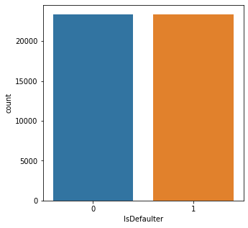
Original unbalanced dataset shape 30000
Resampled balanced dataset shape 46728
Balanced Dataset

Slide 25
Modeling
Performance Metrics
Accuracy is not the best metric to use when evaluating imbalanced datasets as it can be misleading.
In a classification scenario, the model can be evaluated by computing different metrics. In order to better understand these metrics could be useful to get some fundamentals:

Slide 26
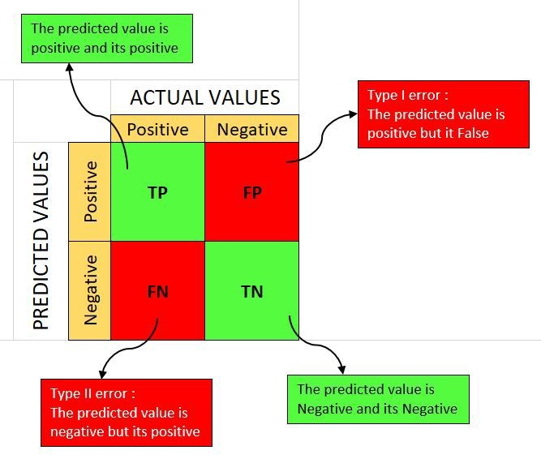

Slide 27
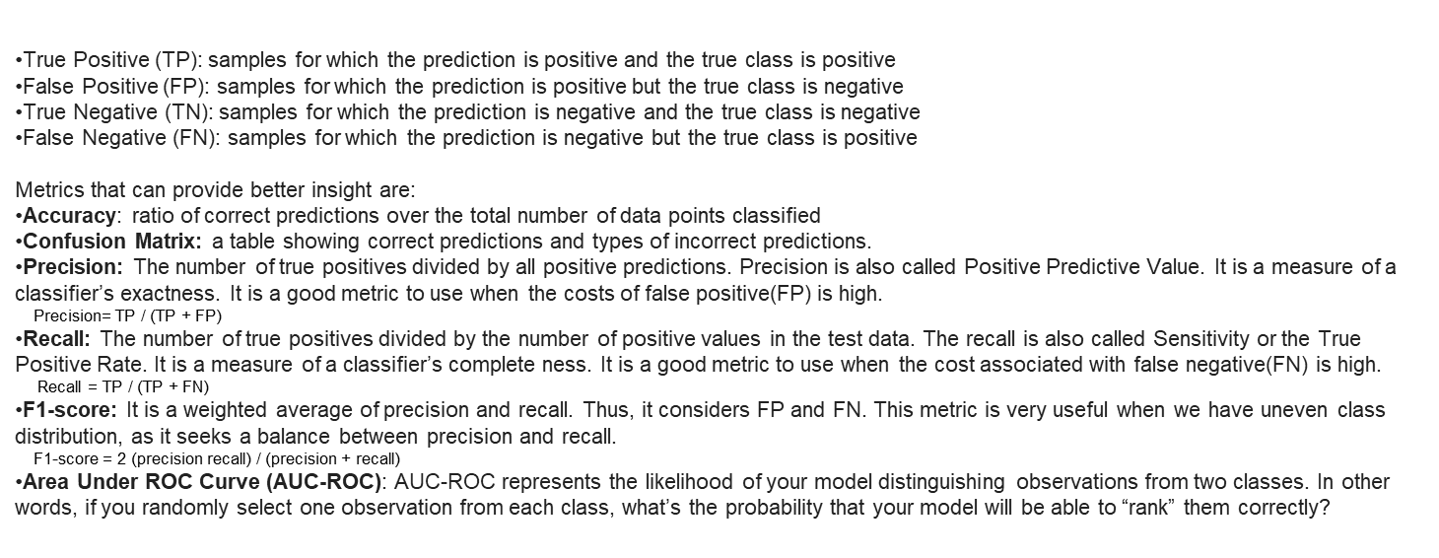
Performance Matrix

Slide 28
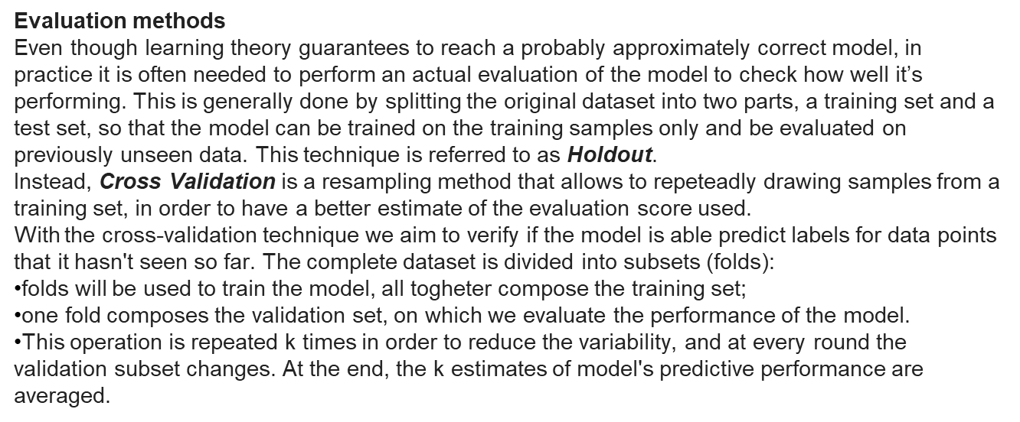

Slide 29
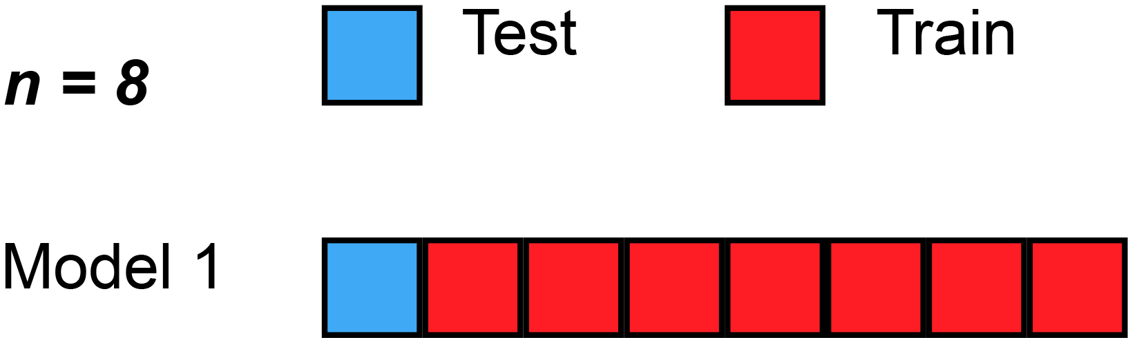
Example of Cross Validation (k=8) where the red and blue square is used respectively as training and validation set
The special case where k is equal to m, the number of examples, is called leave-one-out. This procedures gives a very good estimate of the true error but, on the other side, it computationally expensive.
A combination of holdout and cross validation can be used when also dealing with a validation set (k-fold cross validation). So after having divided the dataset in a stratify way into training and test set, the training part is again splitted into training and validation set (even in this case with stratify=True).

Slide 30
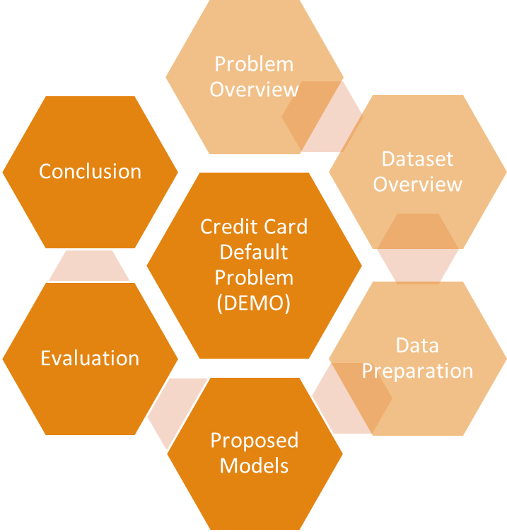

Slide 31
Baseline model implementation

Slide 32
1.Logistic Regression
Logistic Regression is one of the simplest algorithms which estimates the relationship between one dependent binary variable and independent variables, computing the probability of occurrence of an event. The regulation parameter C controls the trade-off between increasing complexity (overfitting) and keeping the model simple (underfitting). For large values of C, the power of regulation is reduced and the model increases its complexity, thus overfitting the data.
The accuracy on train data is 0.755
The accuracy on test data is 0.756
The precision on test data is 0.699
The recall on test data is 0.788
The f1 on test data is 0.741
The roc_score on test data is 0.759

Slide 33
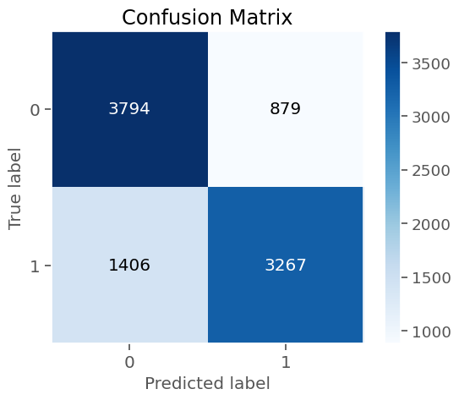

Slide 34
2.Decision Tree Classification
The decision tree starts with a single node, known as the root node, which represents the entire dataset. The root node is divided into subsequent nodes, known as internal nodes, based on the values of a selected feature. These internal nodes lead to further nodes or leaf nodes, which represent the final outcomes or predictions.
The accuracy on train data is 0.999 The accuracy on test data is 0.747 The precision on test data is 0.763 The recall on test data is 0.739 The f1 on test data is 0.751 The roc_score on test data is 0.747

Slide 35
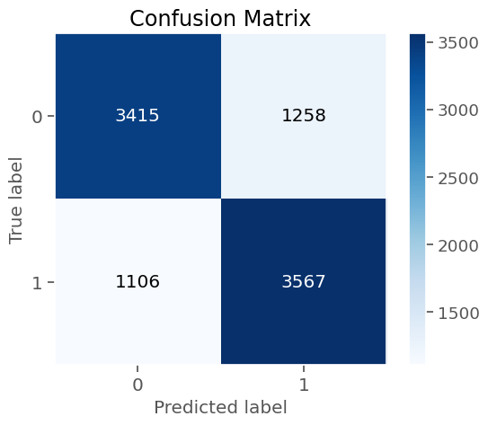

Slide 36
3.Random Forest
A random forest classifier. A random forest is a meta estimator that fits a number of decision tree classifiers on various sub-samples of the dataset and uses averaging to improve the predictive accuracy and control over-fitting
The accuracy on train data is 0.999 The accuracy on test data is 0.836 The precision on test data is 0.805 The recall on test data is 0.859 The f1 on test data is 0.831 The roc_score on test data is 0.838

Slide 37
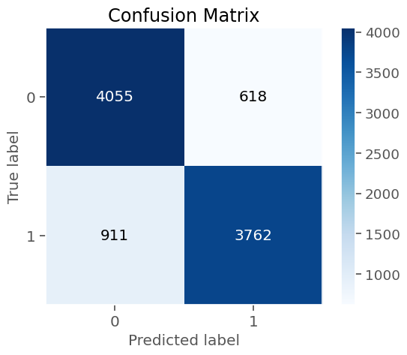

Slide 38
4.Support Vector Machine
The basic concept behind SVM is to find an optimal hyperplane that separates the data points into different classes while maximizing the margin between the classes. In the case of linearly separable data, the hyperplane is a line in two dimensions or a plane in higher dimensions. The SVM algorithm aims to find the hyperplane that maximizes the distance between the nearest data points from each class, known as support vectors.
The accuracy on train data is 0.79 The accuracy on test data is 0.777 The precision on test data is 0.717 The recall on test data is 0.815 The f1 on test data is 0.763 The roc_score on test data is 0.781

Slide 39
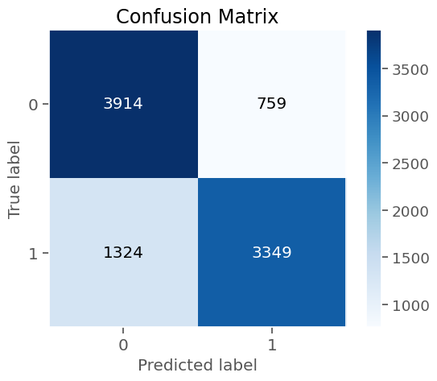

Slide 40
5.Gradient Boosting
The main idea behind gradient boosting is to optimize a loss function by iteratively minimizing the residuals or errors of the previous models in the ensemble. This is achieved by training new models to predict the residuals and then adding them to the ensemble. In each iteration, the new model is trained on the residuals, and its predictions are added to the previous predictions, gradually reducing the overall error..
The accuracy on train data is 0.788 The accuracy on test data is 0.783 The precision on test data is 0.73 The recall on test data is 0.817 The f1 on test data is 0.771 The roc_score on test data is 0.786

Slide 41


Slide 42
6.Xtreme Gradient Boosting(XGB)
XGBoost provides a wrapper class to allow models to be treated like classifiers or regressors in the scikit-learn framework.
The XGBoost model for classification is called XGBClassifier. We can create and and fit it to our training dataset. Models are fit using the scikit-learn API and the model.fit() function.
The accuracy on train data is 0.882 The accuracy on test data is 0.824 The precision on test data is 0.785 The recall on test data is 0.852 The f1 on test data is 0.817 The roc_score on test data is 0.826

Slide 43


Slide 44
Baseline Model evaluation

Slide 45
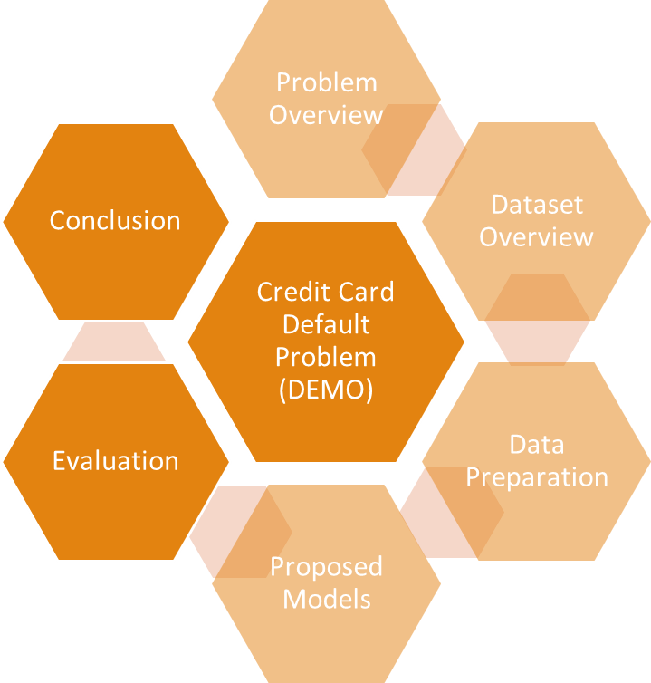

Slide 46
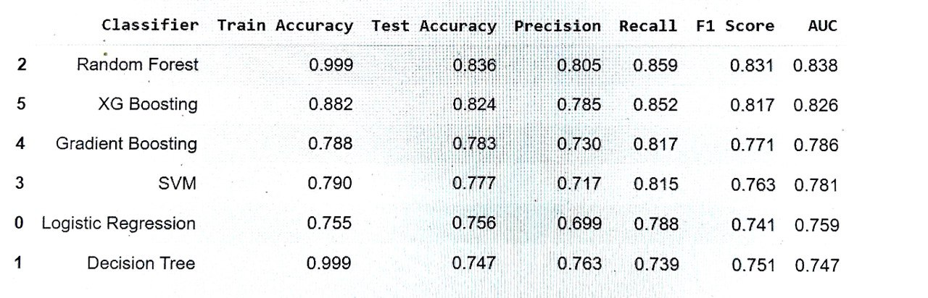
Evaluate all models

Slide 47
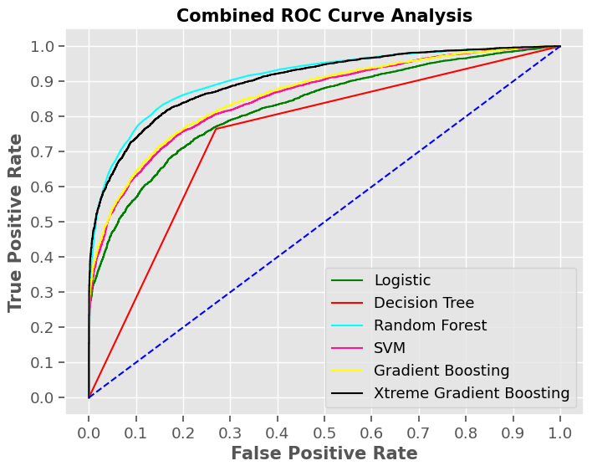

Slide 48
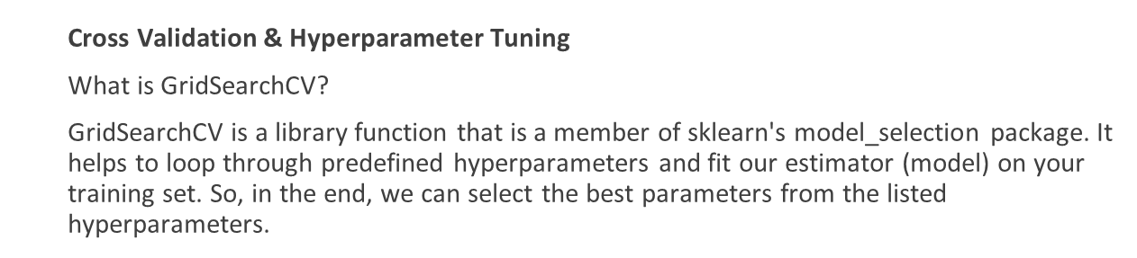
1.Logistic Rgression With Cross Validation
The accuracy on train data is 0.755
The accuracy on test data is 0.756
The precision on test data is 0.699
The recall on test data is 0.788
The f1 on test data is 0.741
The auc on test data is 0.759

Slide 49
2.Decision Tree Classifier With Cross Validation
The accuracy on train data is 0.794
The accuracy on test data is 0.747
The precision on test data is 0.721
The recall on test data is 0.76
The f1 on test data is 0.74
The auc on test data is 0.747

Slide 50
3.Random forest With Cross Validation
The accuracy on train data is 0.802
The accuracy on test data is 0.785
The precision on test data is 0.741
The recall on test data is 0.813
The f1 on test data is 0.776
The auc on test data is 0.788

Slide 51
4.Support Vector Machine With Cross Validation
The accuracy on train data is 0.81
The accuracy on test data is 0.783
The precision on test data is 0.727
The recall on test data is 0.818
The f1 on test data is 0.77
The auc on test data is 0.786

Slide 52
5.Gradient Boosting with cross validation
The accuracy on train data is 0.997
The accuracy on test data is 0.852
The precision on test data is 0.834
The recall on test data is 0.865
The f1 on test data is 0.849
The auc on test data is 0.852

Slide 53
6.Xtreme Gradient Boosting(XGB) With Cross Validation
The accuracy on train data is 0.882
The accuracy on test data is 0.824
The precision on test data is 0.785
The recall on test data is 0.852
The f1 on test data is 0.817
The auc on test data is 0.826

Slide 54
Final Model Evaluate

Slide 56
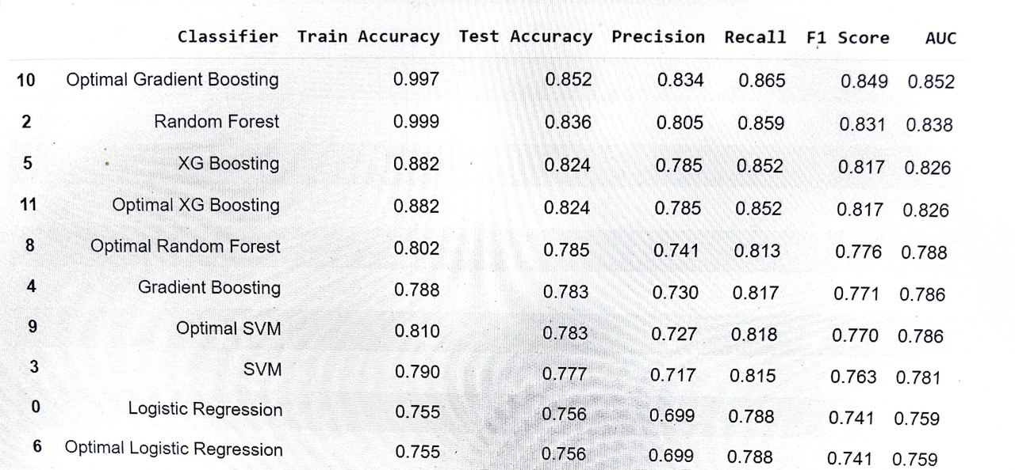
Final Evaluate all models
f

Slide 57
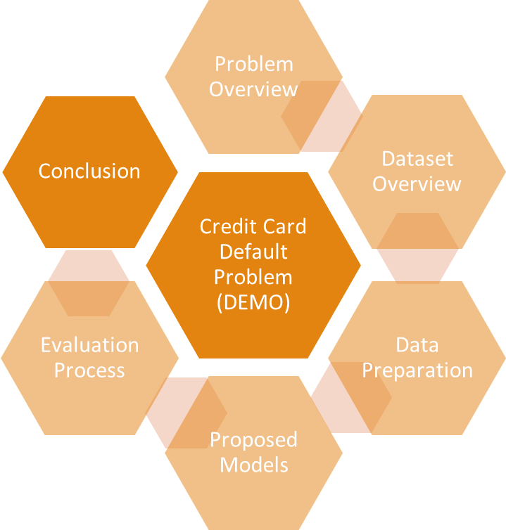

Slide 58
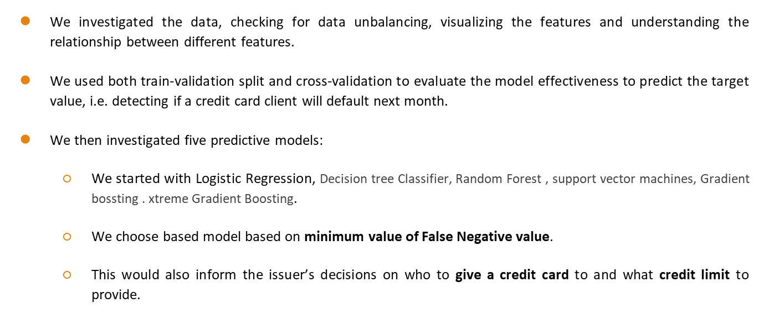
Conclusion

Slide 59
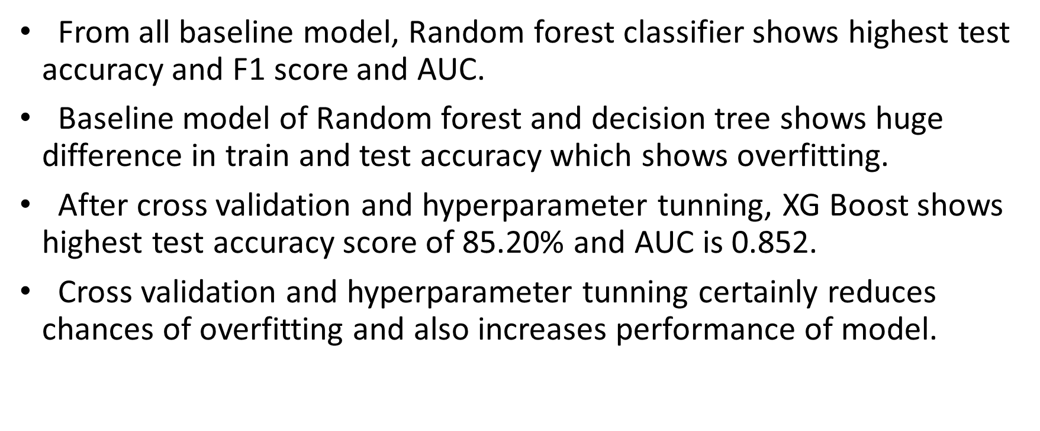

Slide 60
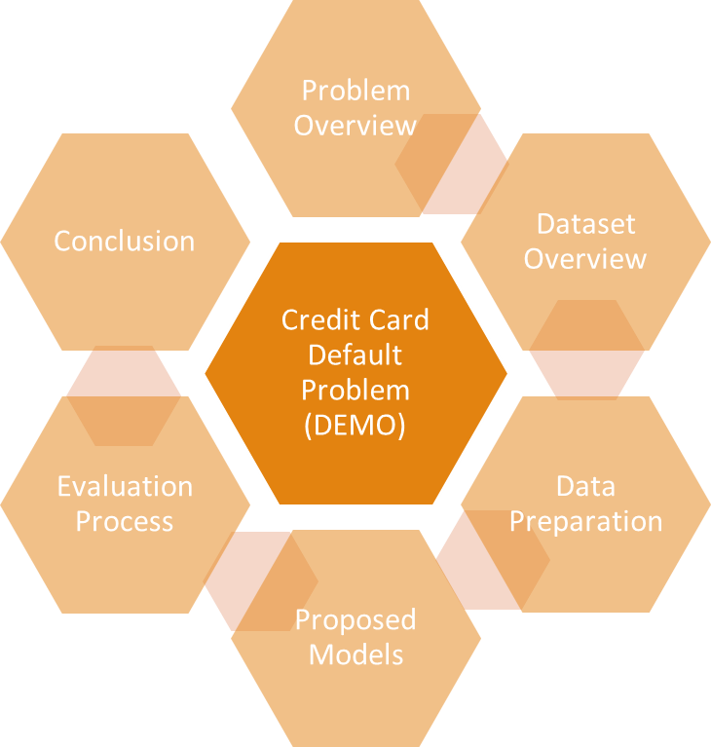

Slide 61


Slide 62

THANK YOU

